Slide 1
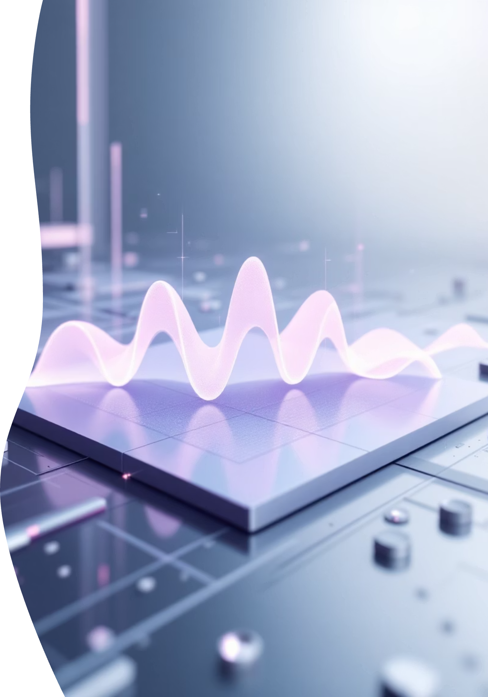
AI Live Meeting Summarizer
By: Prachiti Morankar

Slide 2

Project Overview
A comprehensive end-to-end solution that transforms meeting audio into actionable summaries with seamless export and delivery options.
Audio Capture
Smart Processing
Live recording and file upload support for flexible input methods
TF-IDF extractive summarization for key insights extraction
Export Options
Delivery System
PDF, Markdown, and TXT formats for versatile distribution
Automated email delivery with comprehensive session logging

Slide 3
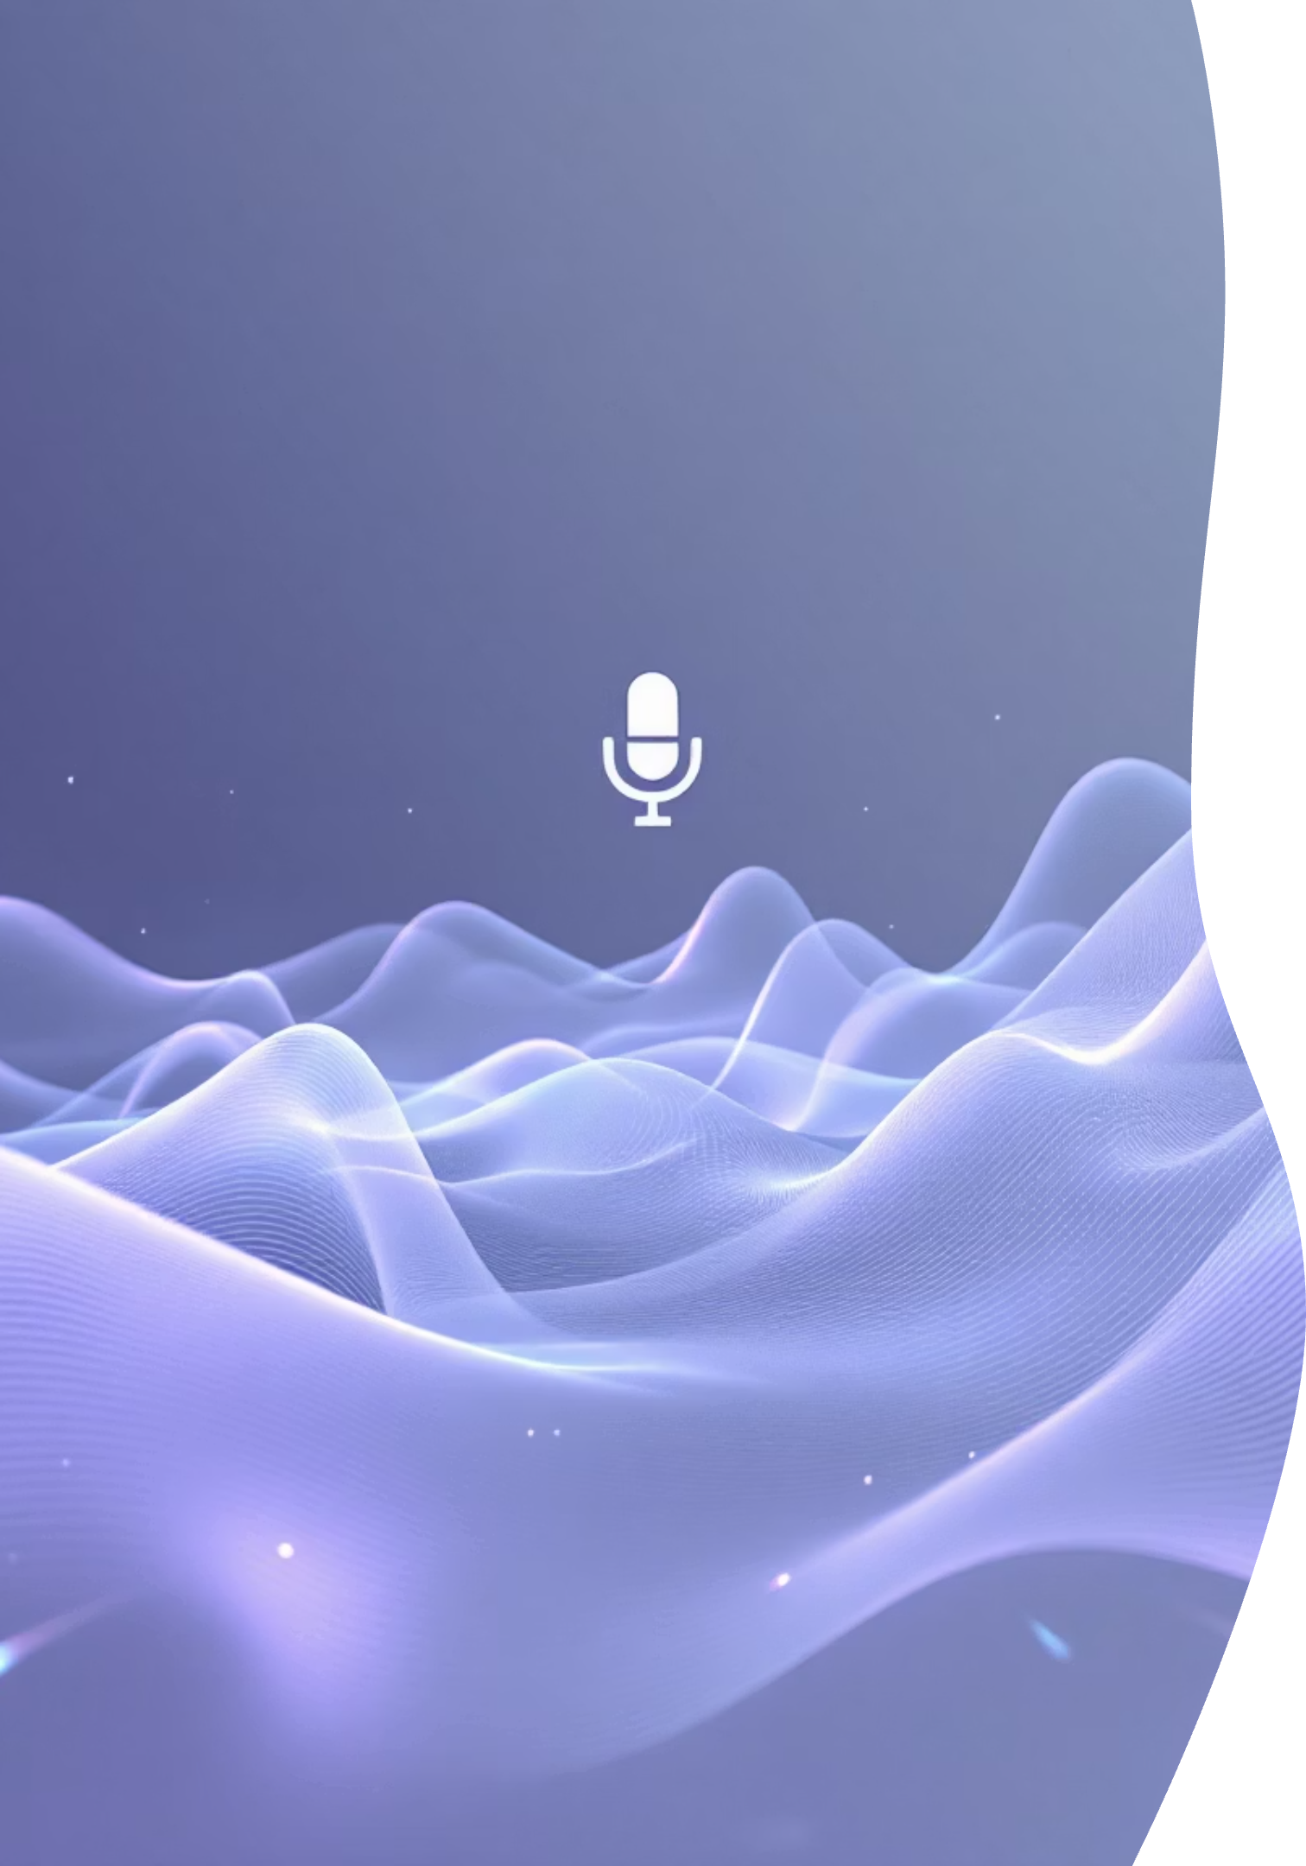
Speech-to-Text
The foundation of our system: converting spoken words into accurate, machine-readable text using industry-standard recognition technology.
01
02
Google SpeechRecognition Integration
Dual Input Support
WAV file upload and real-time microphone recording capabilities
Implemented robust speech recognition engine with high accuracy rates
03
Quality Assurance
Target Word Error Rate (WER) below 15% through audio preprocessing

Slide 4

Summarization
Intelligent Content Extraction
Leveraging TF-IDF (Term Frequency-Inverse Document Frequency) methodology to identify and extract the most relevant information from transcribed content.
Key Performance Metrics
ROUGE score target exceeding 0.40 for summary quality
Extractive approach preserves original phrasing
Clean, structured output with logical flow
Automatic key point identification

Slide 5
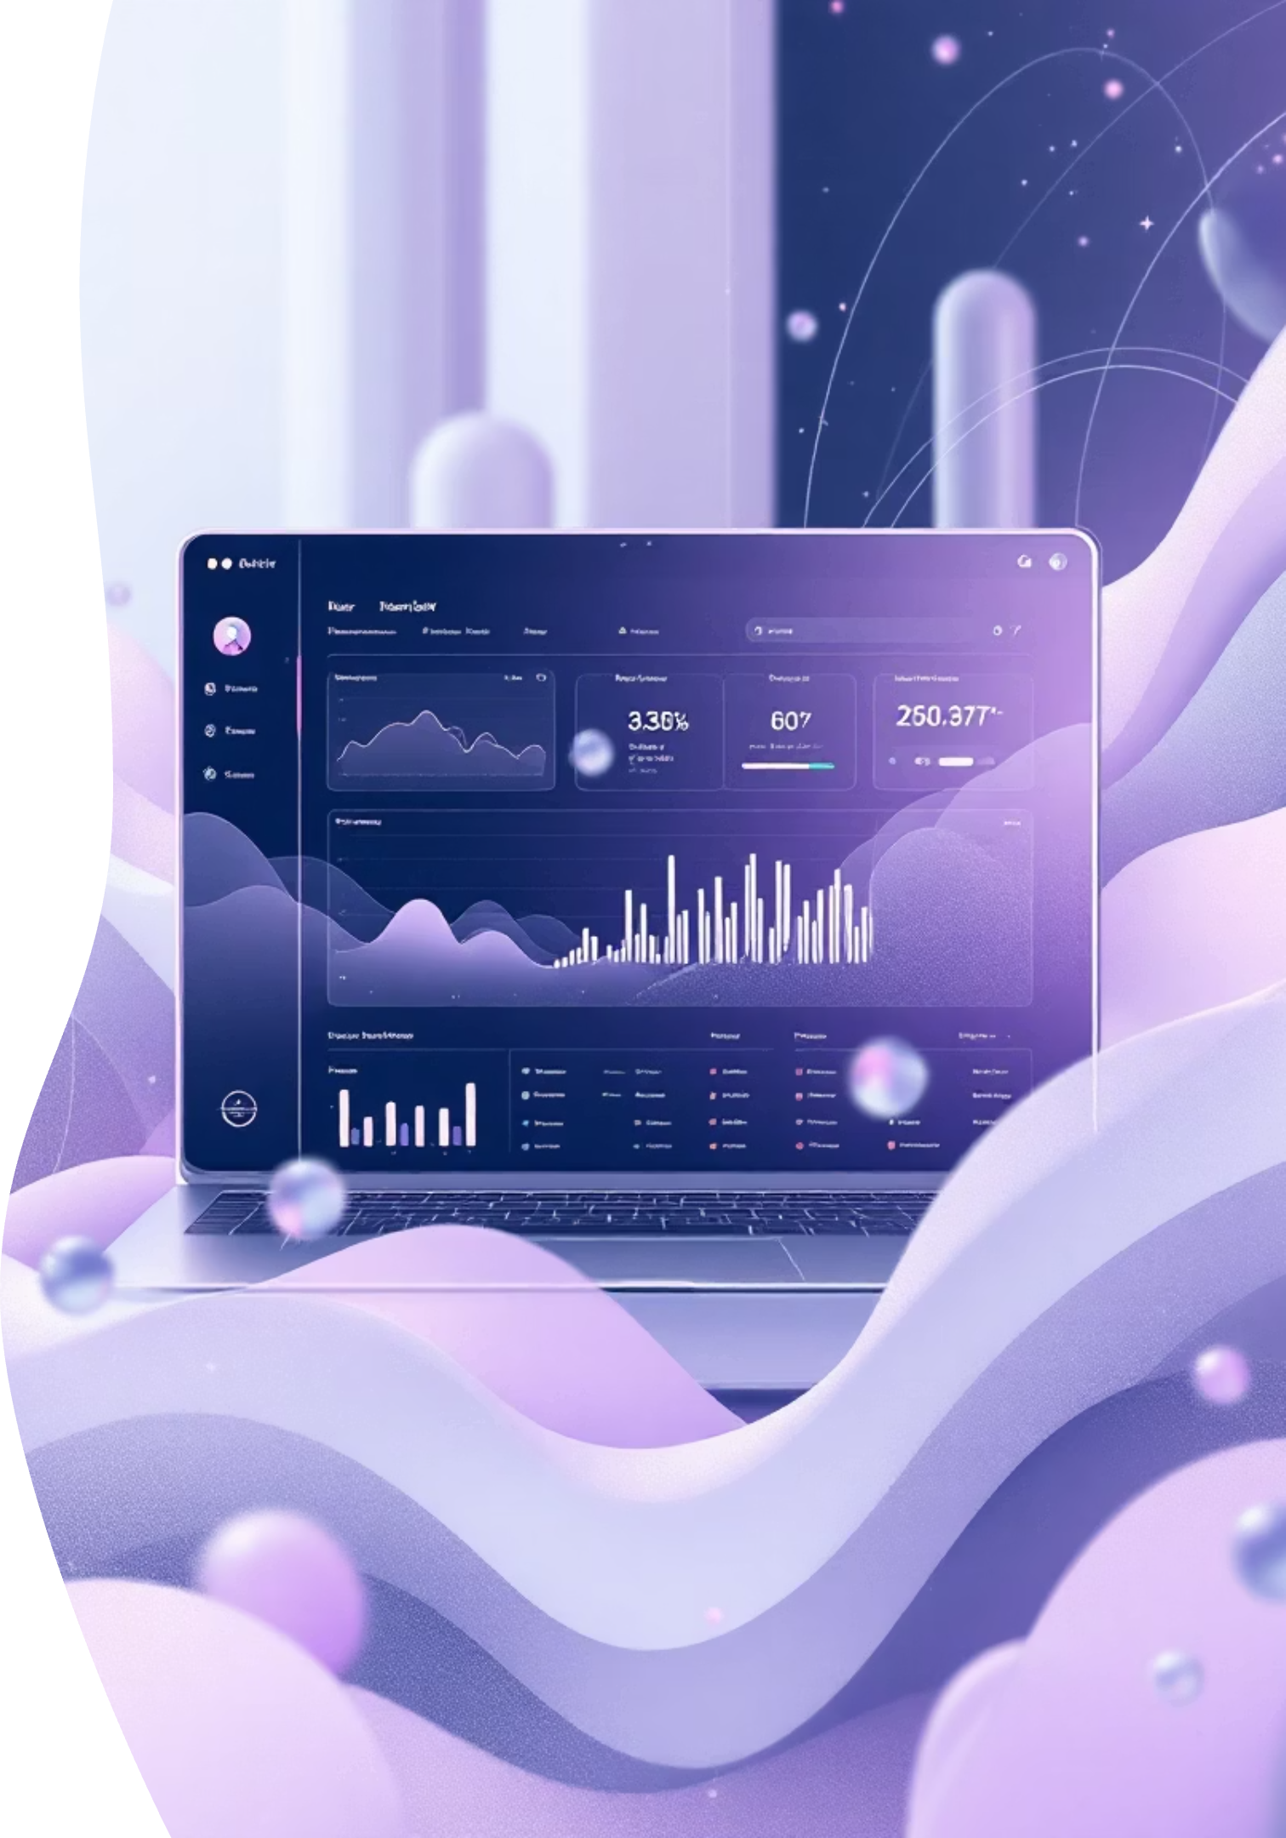
UI Integration
Designing an intuitive, professional interface that makes meeting summarization accessible to all users, regardless of technical expertise.
Streamlit Framework
Built on modern, responsive web framework for seamless user experience
Flexible Workflow
Choose between live recording or file upload based on user needs
Professional Design
Modern blue theme with clean typography and intuitive navigation
Real-Time Display
Instant transcription and summary visualization upon processing

Slide 6

Final Delivery
Completing the ecosystem with comprehensive export capabilities, automated distribution, and session tracking for enterprise-grade functionality.
Export Capabilities
Delivery & Tracking
PDF format: Professional documents with formatted layout
SMTP email: Automated delivery to stakeholders
Session logging: JSON and CSV format tracking
Markdown: Developer-friendly plain text with structure
Full integration: All components working seamlessly
TXT files: Universal compatibility for any system

Slide 7






System Architecture
A modular, scalable design that ensures reliability and maintainability across all components of the meeting summarization pipeline.
Flexible Workflow
Professional Design
Live recording or file upload
Real-Time Display
Modern blue theme UI
Export Capabilities
Instant transcription & summary
Delivery & Tracking
PDF, Markdown, TXT exports
Automated delivery and logs
Audio Input
File upload or live recording
STT Engine
Speech recognition processing
TF-IDF Summarizer
Intelligent content extraction
Export System
Multi-format generation
Email & Logging
Delivery and tracking

Slide 8
Tools & Technologies Used
Python
scikit-learn (TF-IDF Vectorizer)
Used as the primary programming language for backend logic, audio processing, summarization, and handling exports/emails.
Implemented extractive summarization using sentence ranking based on importance scores.
Streamlit
fpdf2
Modern UI framework used to build the web interface for recording audio, uploading files, displaying transcription & summary.
Used to export summaries and transcripts as downloadable PDF files with Unicode-safe fonts.
SpeechRecognition (Google Web Speech API)
SMTP (smtplib + Gmail App Password)
Used for converting speech→text from WAV recordings or uploads. No API key required.
Email system used to send summaries with PDF/MD/TXT attachments directly from the app.
sounddevice
JSON / CSV Logging
Used to record live microphone audio in real time and save it as .wav.
Session-based logging system to store transcripts, summaries, timestamps, and metadata for future reference.
NumPy
Used for numerical operations, helping with text processing and TF-IDF matrix calculations.

Slide 9

Challenges & Learnings
Every innovative project faces obstacles. Here's how we overcame technical hurdles to deliver a production-ready solution.
SMTP Authentication
Unicode PDF Handling
Navigated complex email security protocols and app-specific password requirements for reliable delivery
Resolved character encoding issues to support international characters and special symbols in exports
Audio Quality Variations
Streamlit State Management
Implemented preprocessing pipeline to handle diverse audio sources and background noise conditions
Mastered session state handling to maintain data consistency across user interactions
Audio Input
File upload or live recording
STT Engine
Speech recognition processing
Reliable Design
Maintainability across pipeline components
TF-IDF Summarizer
Intelligent content extraction
Export System
Multi-format generation

Slide 10
Challenges I Faced
1. Speech-to-Text Accuracy Issues
3. Gmail SMTP Authentication Failures
5. File Overwrite & Logging Issues
Background noise caused incorrect transcriptions.
Normal password rejected (5.7.8 errors).
Logs were overwritten when sessions repeated.
Had to improve recording clarity and handle exceptions.
Needed to set up App Password and fix formatting issues.
Fixed by timestamp-based folder generation.
2. PDF Export Unicode Errors
4. Streamlit State Reset Problems
6. Long Lines Breaking PDF Layout
Emojis and special characters caused PDF failures.
Outputs were disappearing on every button click.
Multi-line text caused FPDF width errors.
Solved using Unicode-supported TTF fonts.
Solved using st.session_state.
Implemented safe wrapping + line-splitting logic.

Slide 11
Future Scope & Enhancements
1. Offline Speech-to-Text (Vosk / Whisper)
4. Cloud Deployment
Removes Google dependency
Make app publicly accessible
Works without internet
Options: Render, AWS, GCP, Azure
More accurate and customizable
5. Abstractive Summarization with LLMs
2. Speaker Diarization (Who Spoke When)
Use LLaMA, Mistral, GPT-based summarizers
Identify multiple speakers
More human-like summaries
Label Speaker 1, Speaker 2, etc.
6. Action Item Extraction
3. Multilingual Support
Detect tasks, deadlines, key decisions
Support for Hindi, Marathi, Spanish, etc.
Format into bullet points automatically
Automatic language detection

Slide 12
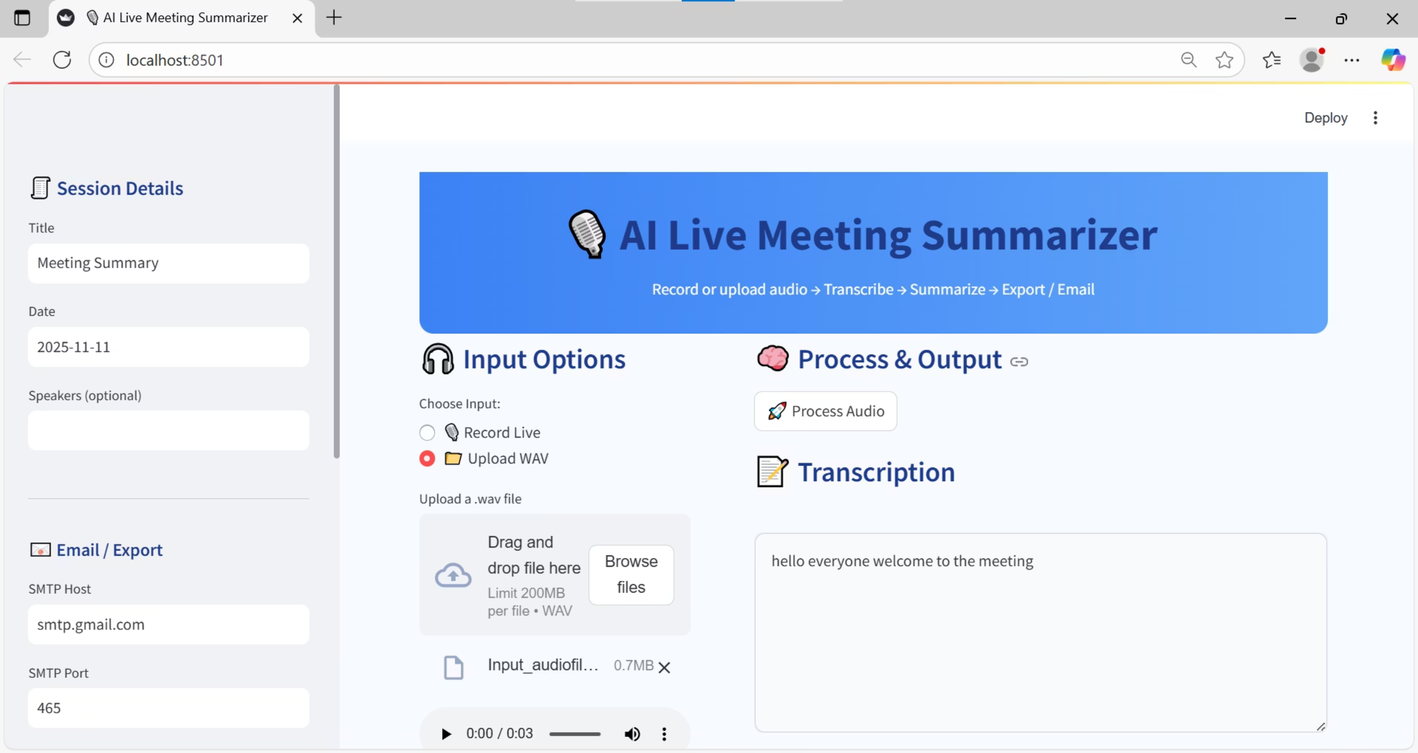

Slide 13
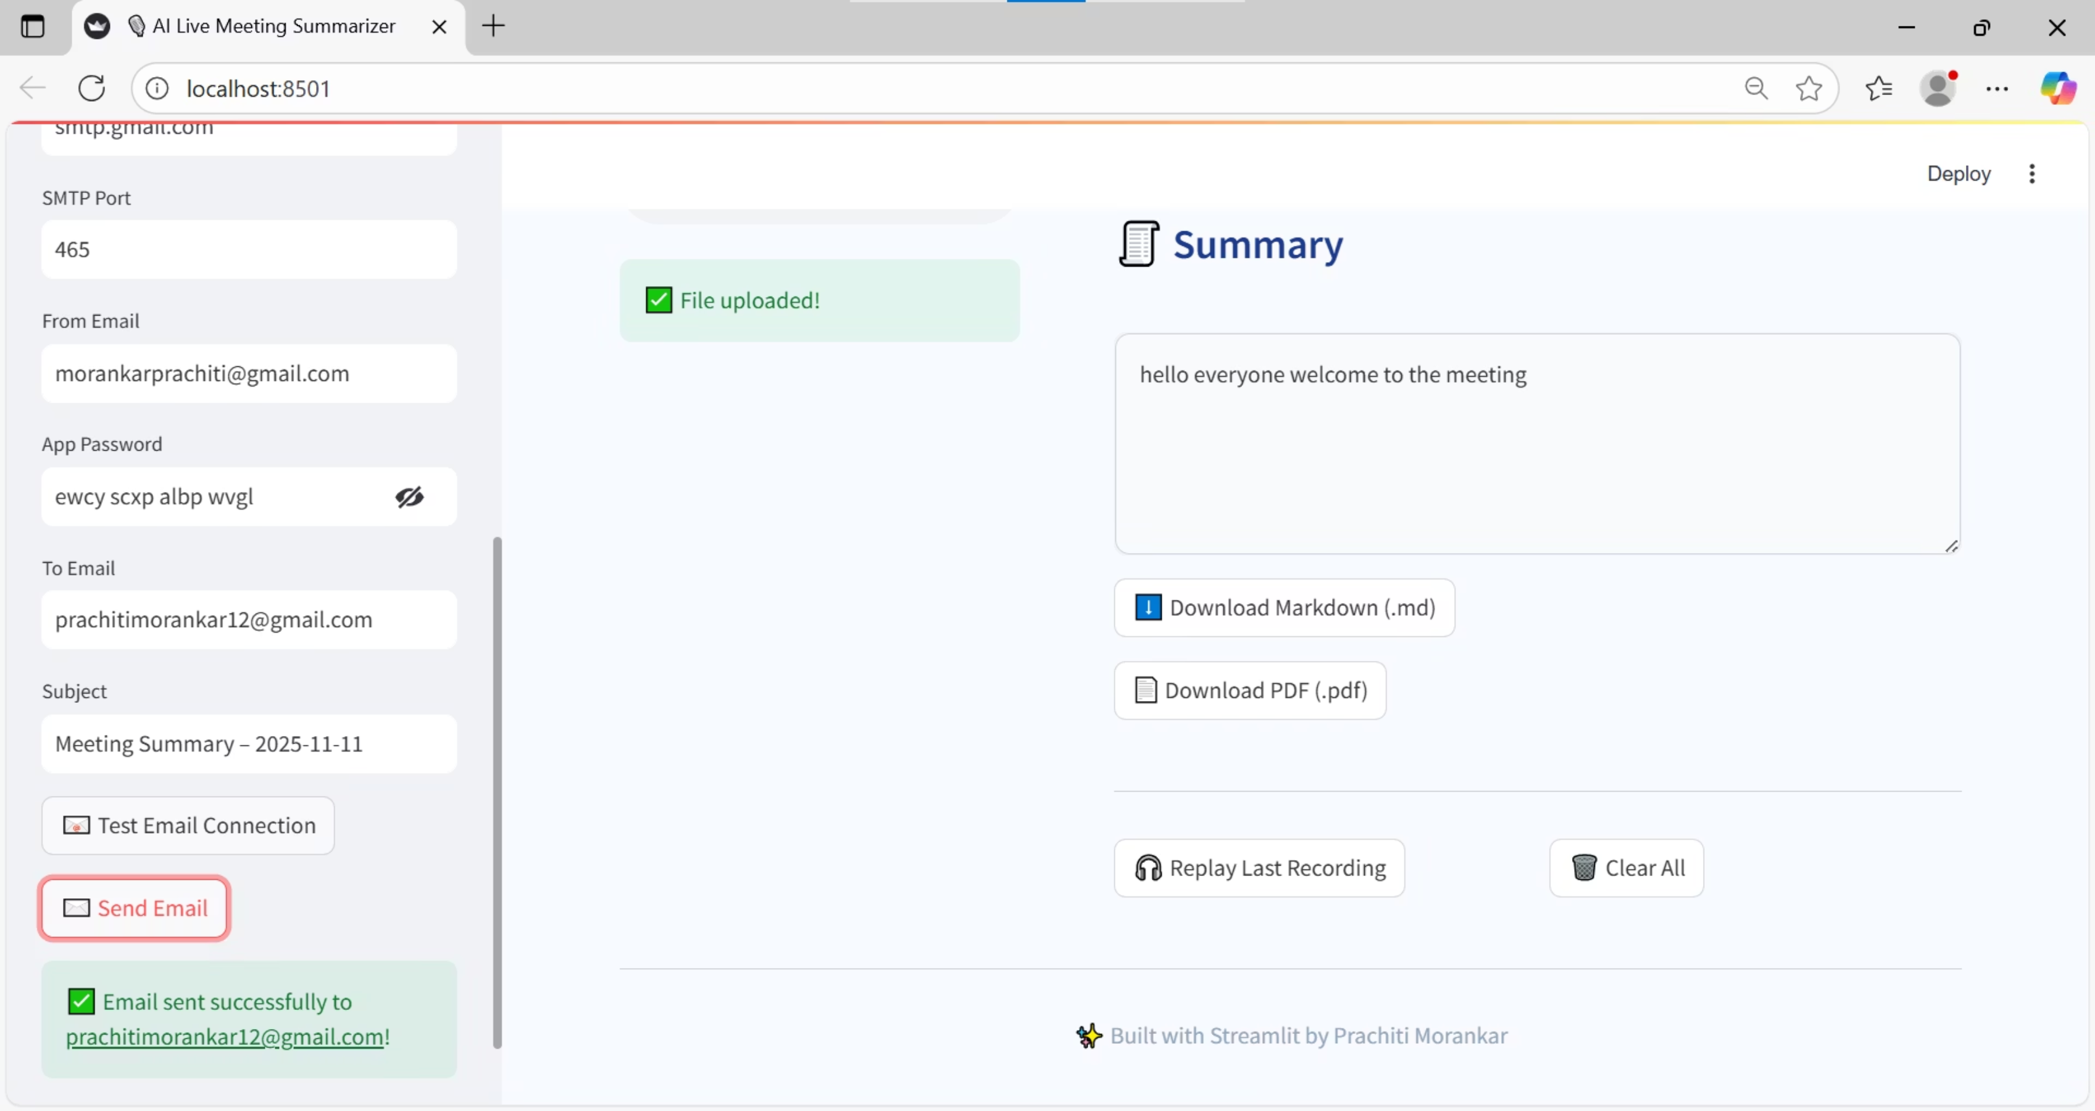

Slide 14


Conclusion
Mission Accomplished
All Four Milestones Completed
Delivered on schedule with all requirements met
Fully Functional Meeting Assistant
End-to-end pipeline from audio to actionable summaries
Professional Export & Delivery
Multiple formats with automated email distribution
Demo-Ready Application
Polished UI ready for stakeholder presentation
Thank you for your attention. Ready for questions and demonstration.
Offline STT
Speaker Diarization
Multilingual Support
Cloud Deployment

